Slide 1
Android Programming Mobile Development
Dr Ian Drumm

Slide 2
A Survey App
Aims:
Object management
Learning Outcomes:
Widgets
Adapters
Recycler View

Slide 3
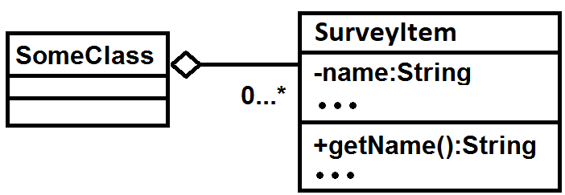
Managing Aggregations of Objects
Manage objects in collections such as ArrayLists, Vectors, Sets, Trees, etc
Import java.util.*
Note the symbol in a UML class diagram

Slide 4
Define a class to hold data item
For example let’s name the class SurveyItem
class SurveyItem {
private String name;
private float rating;
public SurveyItem(String name, float rating)
{
this.name=name;
this.rating=rating;
}
public String getName() {
return name;
}
public float getRating() {
return rating;
}
}

Slide 5
Hence manage aggregation
Create an array list of survey items
Populate with data
ArrayList<SurveyItem> survey=new ArrayList<SurveyItem>();
survey.add(new SurveyItem("KFC",2));
survey.add(new SurveyItem("Mcs",1));
survey.add(new SurveyItem("Chip Shop",3));

Slide 6
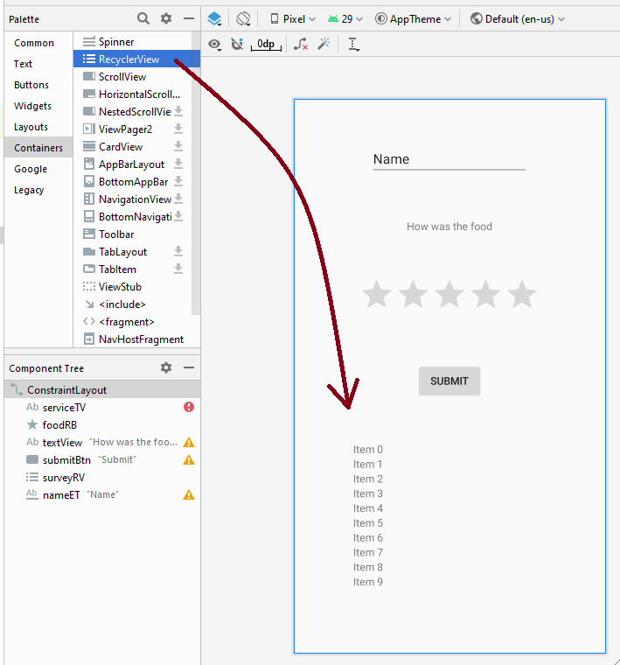
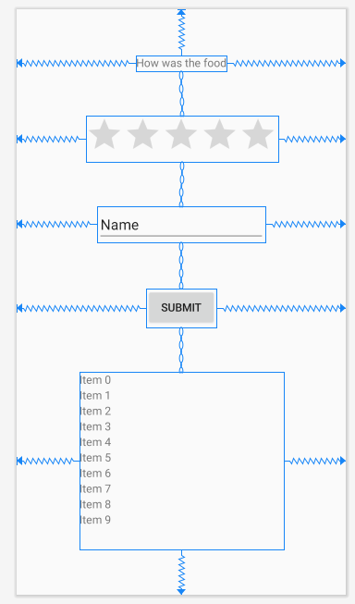
Building the user interface
Drag widgets into the design area

Slide 7
XML Widgets referenced as objects in Java Code
Using findViewById
Reference can hence get or set widget values
nameEditText = findViewById(R.id.editText1);
foodRatingBar = findViewById(R.id.ratingBar1);
submitButton = findViewById(R.id.button1);
String name = nameEditText.getText().toString();
float rating = foodRatingBar.getRating(),

Slide 8
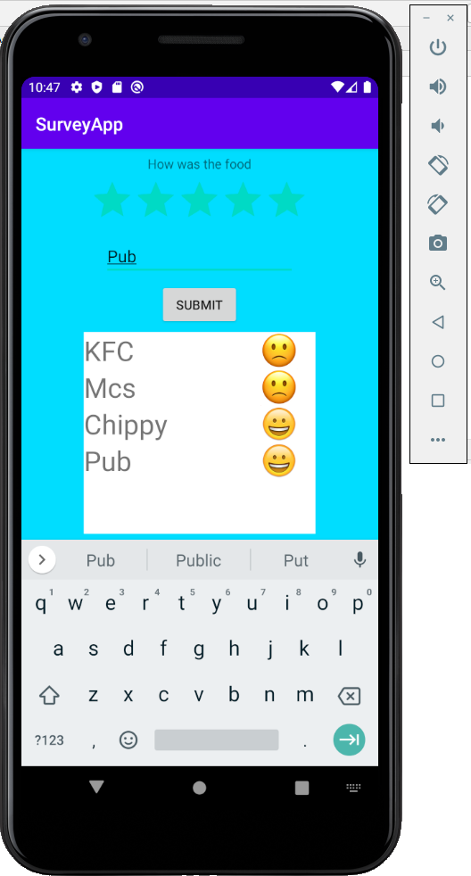
Recycler View
A Composite widget
Used to display lists of items
High customisable
Can link directly to data set with an adapter
Other composite widgets include expandable list view, grid view, search view, etc

Slide 9
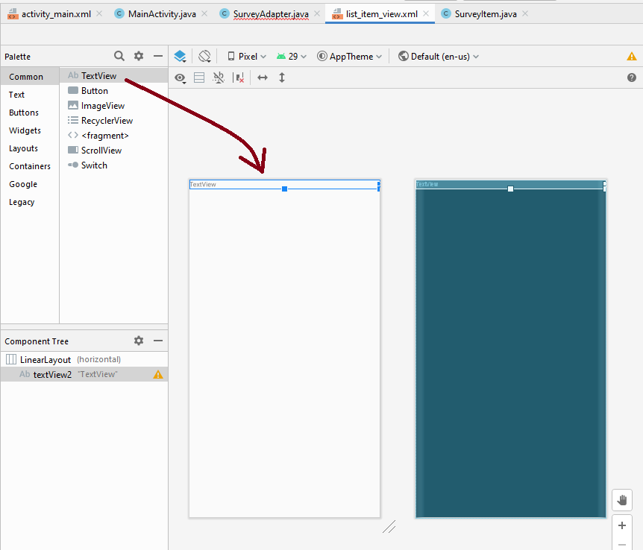
List Item
Can create custom layout (text, image icons, etc) for item in recycler view
In res/layout directory right click to create new android XML file

Slide 10
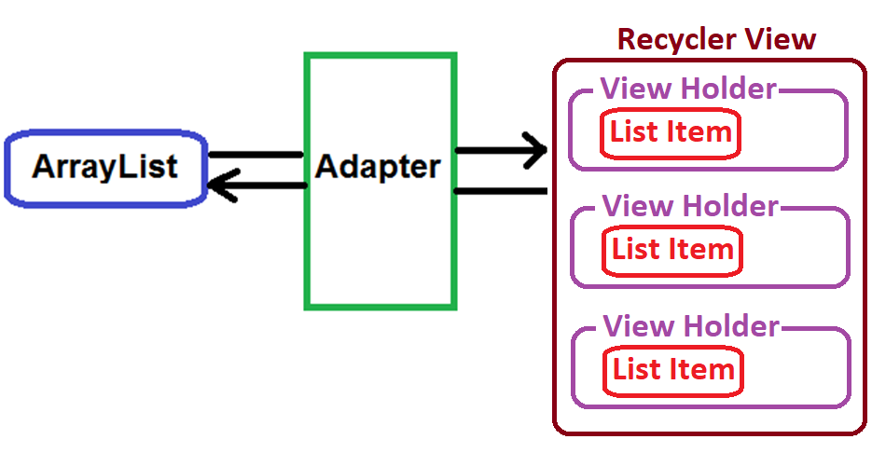
ArrayAdapter
Takes the data from ArrayList and converts it into View Holders containing Widgets
View Holders are displayed in RecyclerView

Slide 11
public class SurveyAdapter extends RecyclerView.Adapter { onCreateViewHolder(...) { view = inflate(list_item); holder = new ViewHolder(view); } onBindViewHolder(){ holder.text_in_list_item.setText(survey.get(position).getName()); } getItemCount() { return survey.size(); } class ViewHolder extends RecyclerView.ViewHolder implements OnClickListener {
TextView text_in_list_item; ViewHolder(View itemView) {
text_in_list_item = itemView.findViewById(text_in_list_item); } onClick(View v) {
// do something }
} }
Inflate and wrap list item in View Holder
Update the View Holder to display survey data
Define an interactive View Holder which will be displayed in you Recycler View

Slide 12
Associate survey with list view via the Adapter
Using the setAdapter() method
adapter = new SurveyAdapter(survey, list_item_view);
surveyRV = findViewById(surveyRecycleView);
surveyRV.setAdapter(adapter);

